Slide 1
Excuber
'
Product introduction

Slide 2
Agenda
What is Excuber?
Excuber modules
Sample Excuber implementation use-cases

Slide 3
What is Excuber?
Excuber is a system for automatic image processing using its modules which can significantly reduce decision making process for the end-users
Simplicity of the manipulation as well as precision of the detection are the key advantages of the system
Excuber can be fully customised based on client requirements
Excuber modules:
Face detection & recognition
Object detection
Color detection
Movement detection
Anomaly detection
License plate detection [EU & US]
Data coupling from multiple modules
Strong analytics
“Excuber will allow you to process data from hundred’s of cameras in the blink of an eye”

Slide 4
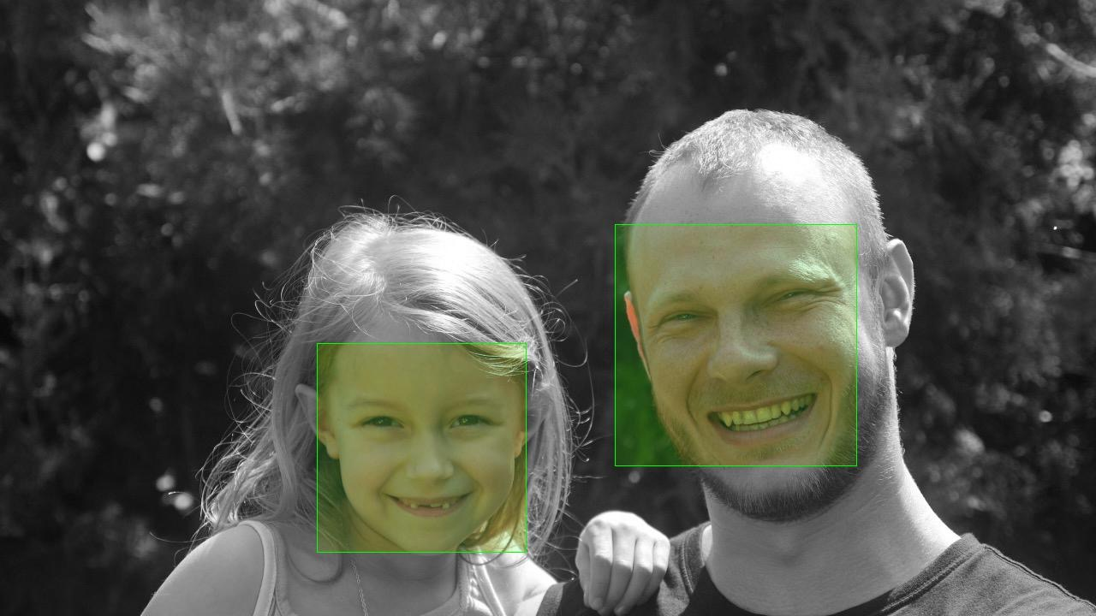
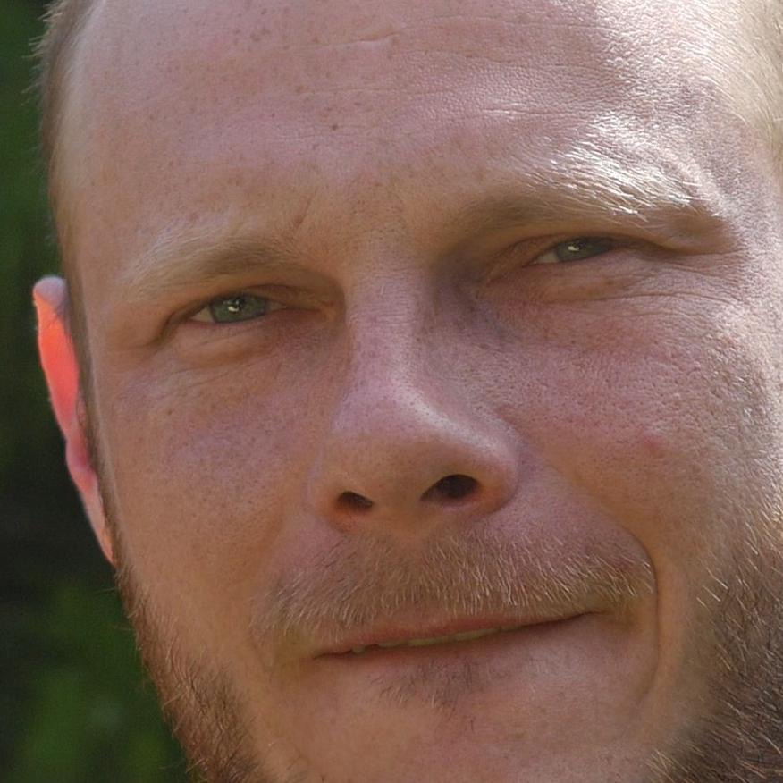
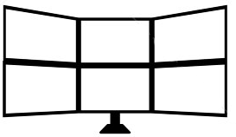
Excuber - Technical Components
Example:
Wanted faces
database
01 Excuber continuously identifies faces from a live camera
Stolen cars license plates
Any other unstructured
data source
Other data
EXCUBER
Object detection
Face detection & recognition
02 Identified faces are continuously compared with face recognition database
Movement detection
License plate recognition
Age & Gender estimation
Rules
Notifications
03 Sample rule: In case that a face is matched with more than 95% probability in 10 consequent frames
Actions
04 Excuber will raise an alert with priority 1
05 After confirmation operator will take an action

Slide 5
Excuber - Functional Components
03
Action
Action
Operator will take the action based on notifications
02
Filtering of false positive data
Comparing results with configured rules
Strong analytics
processing of the data across THE whole system
Data coupling from multiple modules
Trigger notifications
01
Image processing modules
Face detection & recognition
Object detection
Color detection
Modules are processing data coming from the live cameras, video files from archive or solo images
Movement detection
Anomaly detection
License plate detection

Slide 6
Excuber - Detailed Functionality Description
Data entry into the system:
Excuber is able to process live video feed via RTMP protocol, images send via Wifi network or videos & images stored in archive
Image processing modules:
Face detection & recognition
Object detection
Color detection
Movement detection
Anomaly detection
License plate detection [EU & US]
Processing of other data:
Regular feeds of unstructured data from other databases could be established
New data sources can be easily implemented based on client requirements
Application usage by operator:
Using mobile application or via classic PC it is possible to view live original live stream, processed live stream, receive notifications as well as search thru historical data
Additional data representation could be implemented (for example):
view all notification on the map
locate where a specific person was seen for the last time
show all the notifications with certain priority in selected time range
Rules:
It is possible to define rules based on which application will trigger notifications
Rules could use data from modules or any other unstructured data loaded into the system
Notification:
Notifications can be send to the mobile application or in standard formats as SMS, MMS or email.

Slide 7
Excuber Modules

Slide 8
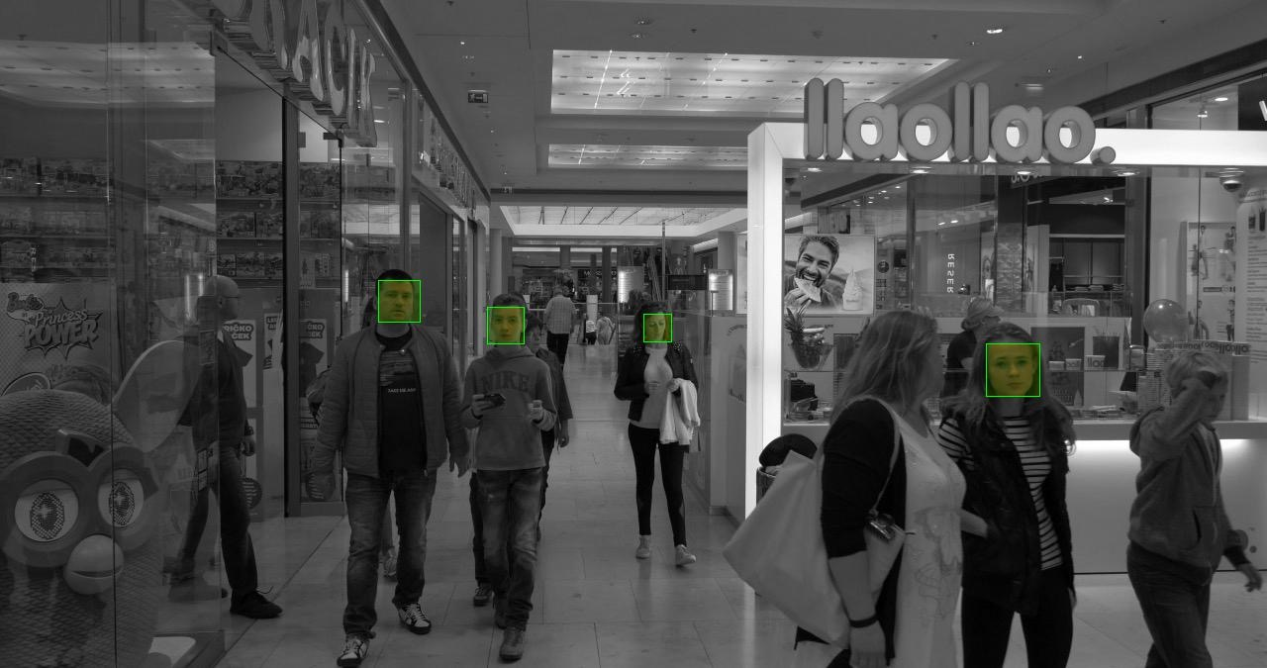
Face Detection and Recognition
Face detection and recognition - examples
Module processes each frame from live video feed or archive video file
Multiple faces can be recognised on each frame
Each detected face is represented by the green square
System could detect face rotated +/- 50 degrees horizontally and +/- 40 degrees vertically
After a successful face detection system processes each face separately and could perform:
Age and Gender estimation
Compare the face with a database and provide a matching factor
Continuously monitor face movement across the frame of the camera as well as thru multiple cameras connected to the system
Precision of the face recognition module can be configured
Face detection algorithm can be trained for specific applications
Age and Gender estimation algorithm could be trained to improve estimation precision

Slide 9
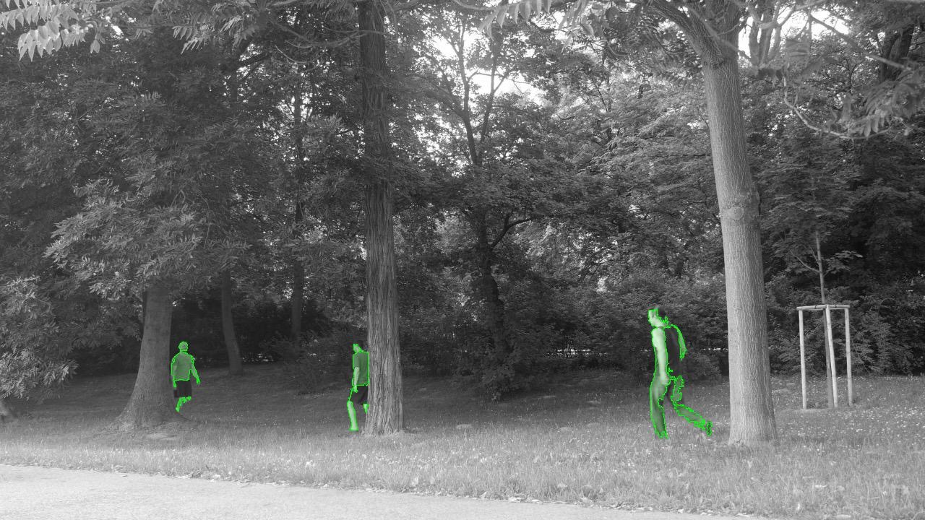
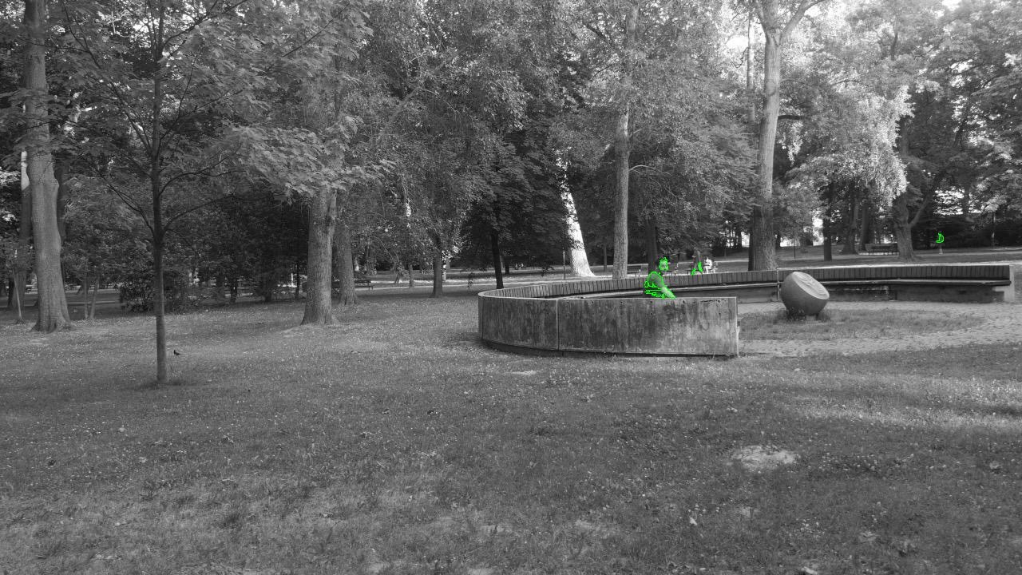
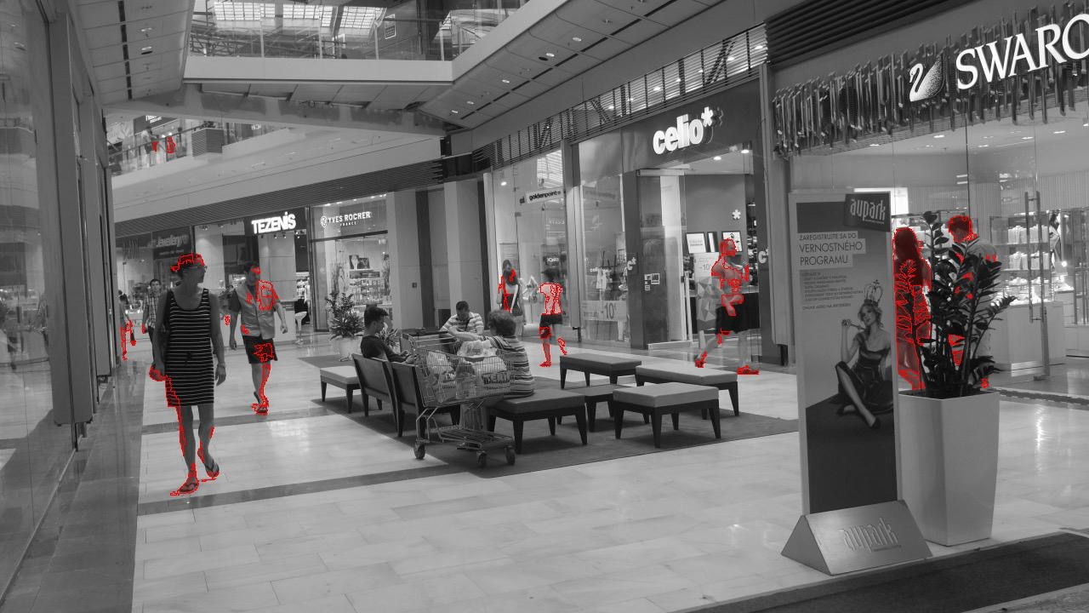
Movement Detection
Movement detection - examples
Module processes each frame from live video feed or archive video file
Movement in the frames can be detected using self learning algorithm
Minimal and maximal size of detected objects could be configured
Object as small as 10 pixels could be detected
Filtering of false positive detections is available

Slide 10
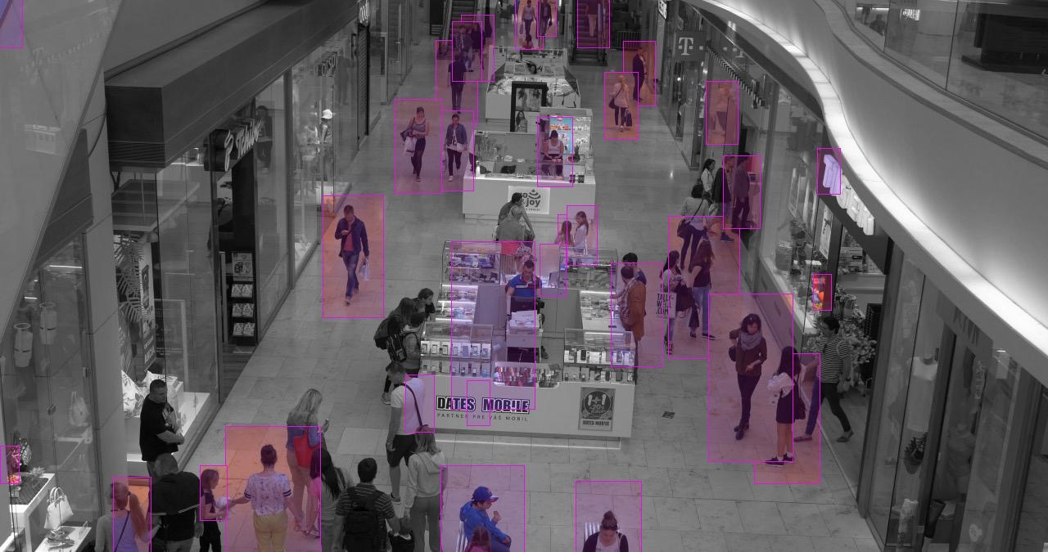
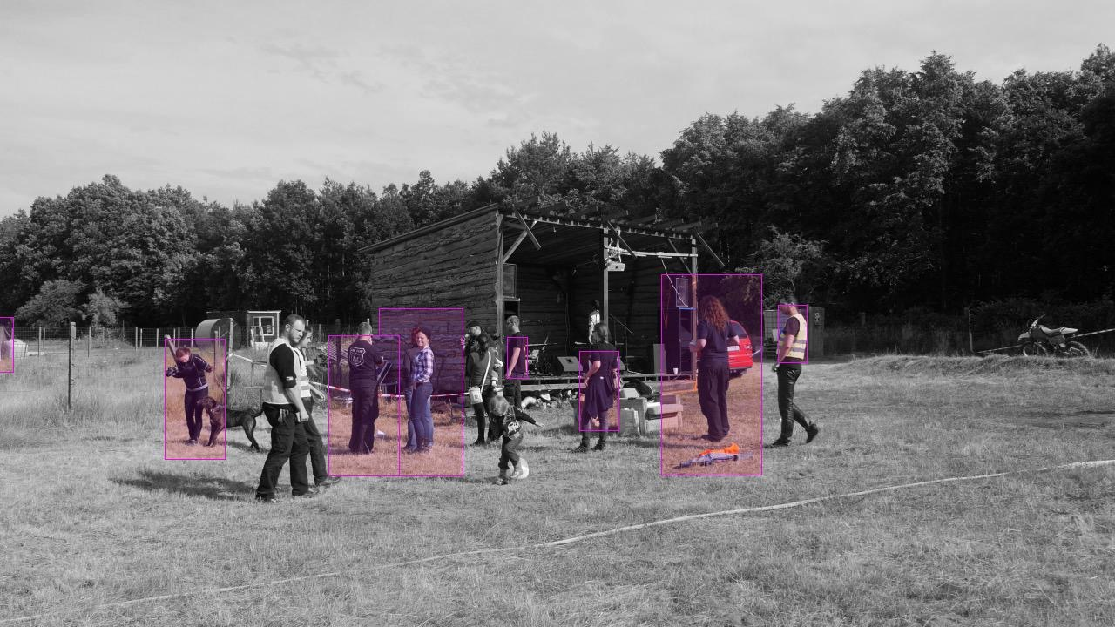
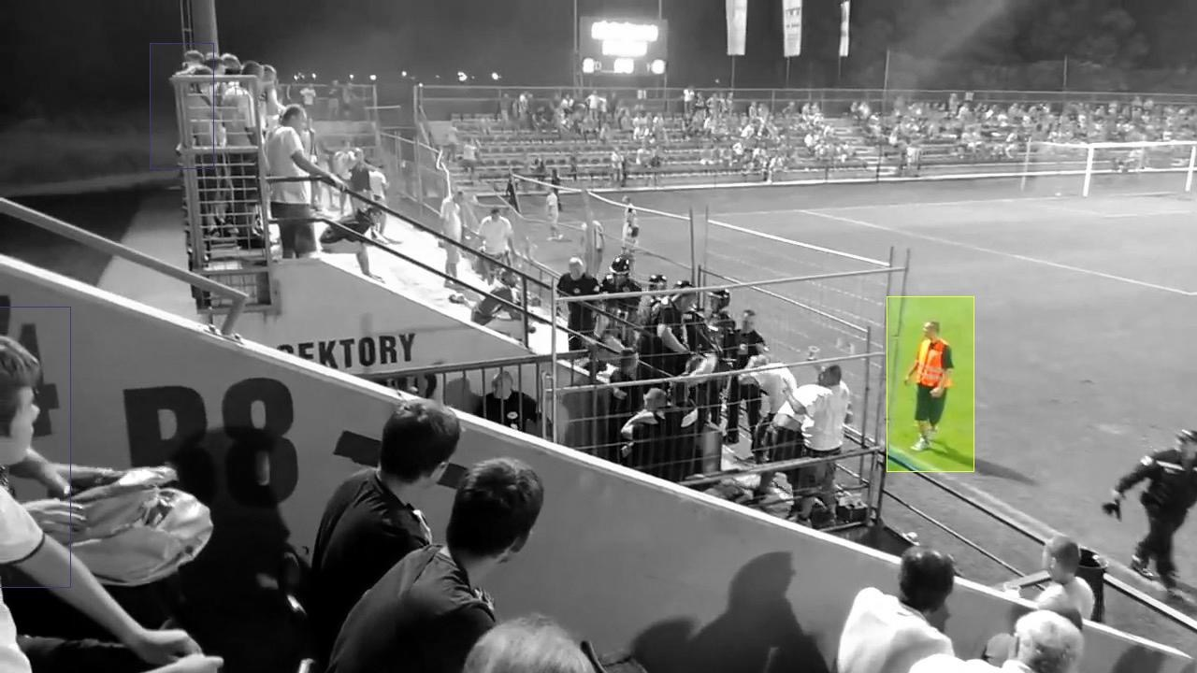
Object and Colour Detection
Object and colour detection - examples
Module processes each frame from live video feed or archive video file
Object recognition in each frame uses templates defined in advanced
Multiple objects can be detected in one frame
Template training for new objects is available
For each detected object colour recognition can be applied in order to detect dominant colour
Example: detect all humans in the picture and identify those which are wearing reflex vest

Slide 11
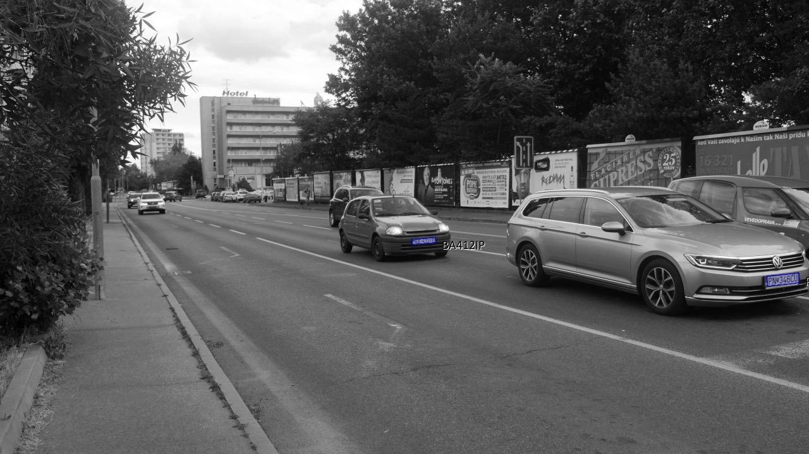
License Plate Detection
License plate detection - examples
Module processes each frame from live video feed or archive video file
Module can detect multiple license plates in one frame
Recommended maximum tilt of the plate is 30 degrees (module could go beyond that)
All European and US license plates are supported

Slide 12
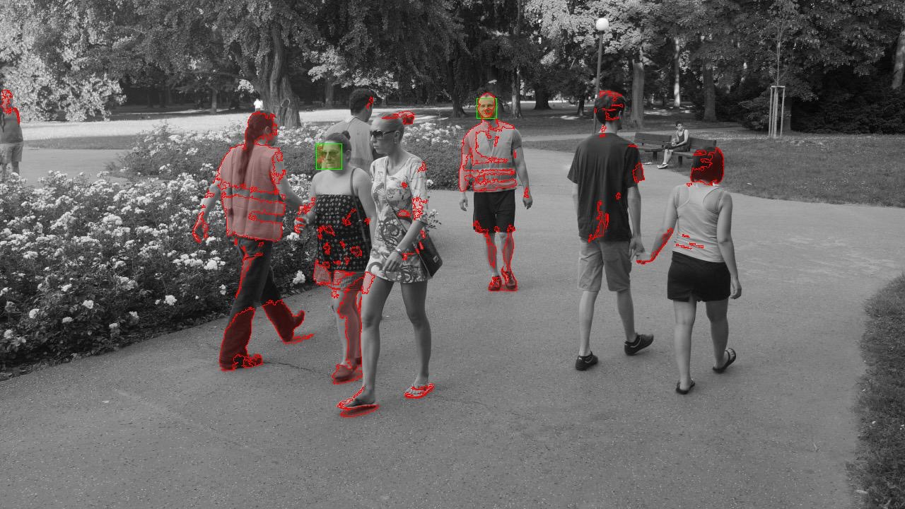
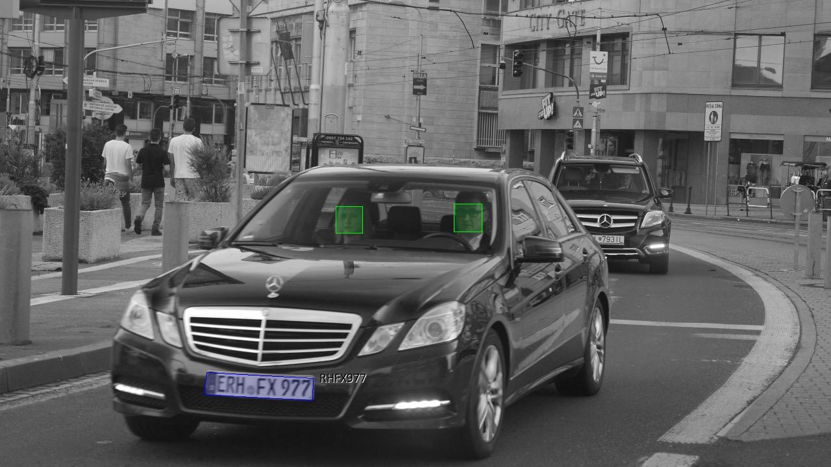
Data Coupling from Multiple Modules
Data coupling from multiple modules - examples
Excuber can combine data from multiple modules from live video feeds or archive video files together
This could be used to generate output video or combine data for very sophisticated rules and notifications
Examples of very sophisticated rules
Confirm if the specific car is driven by the same driver
Confirm if a colour of clothes of the specific person is the same
Which car was driven by selected person
and so on …

Slide 13
Sample System Use-cases
Excuber is well suited for:
Detection of unwanted people
Monitoring of public gathering
Securing and monitoring of buildings
Monitoring of entrances
Car detection
Analysis of non standard behaviour in crowds
Deep analytics for retail sector
“Excuber’s implementation possibilities are endless”

Slide 14
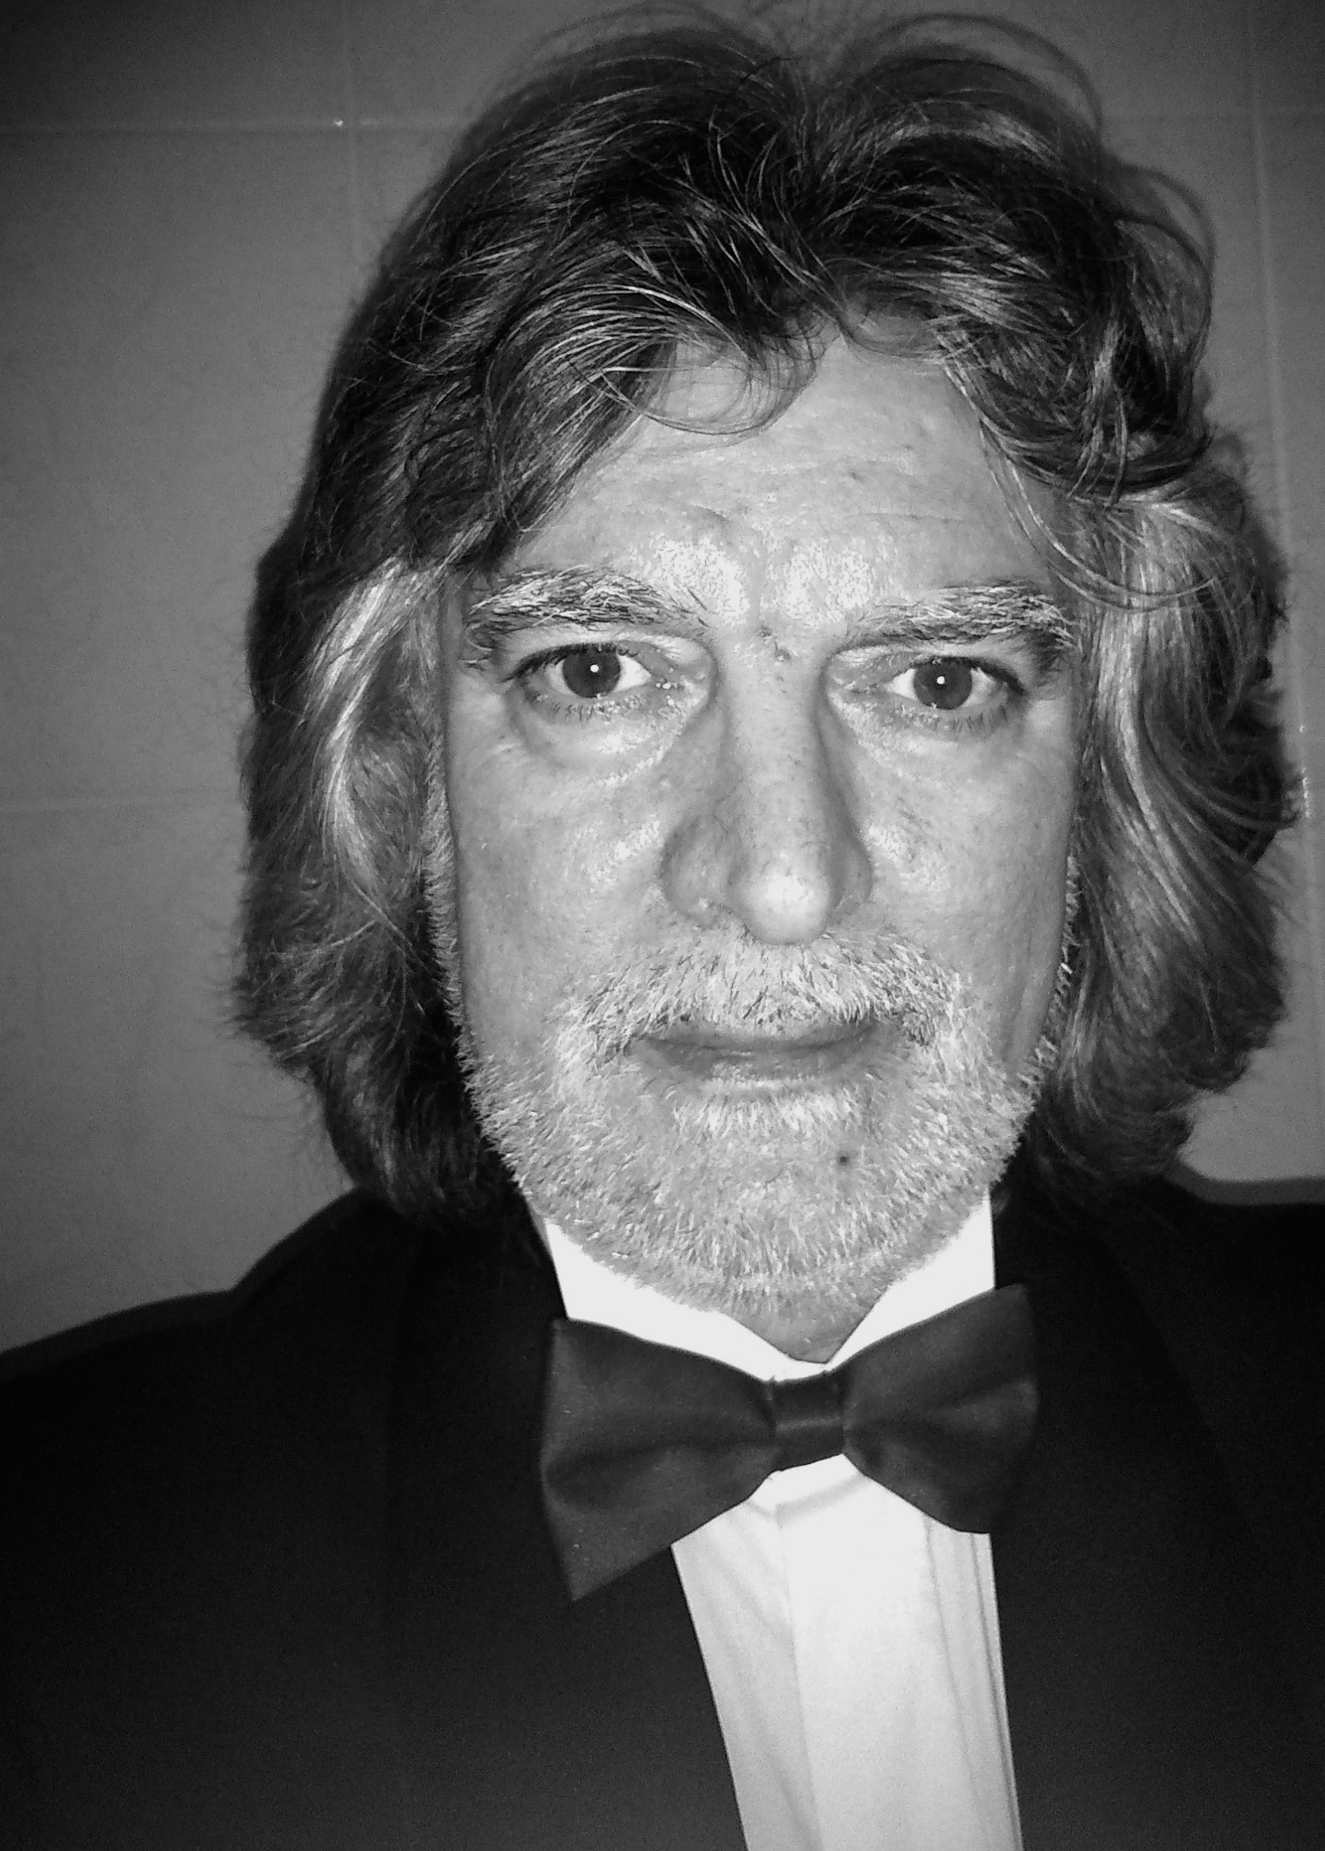
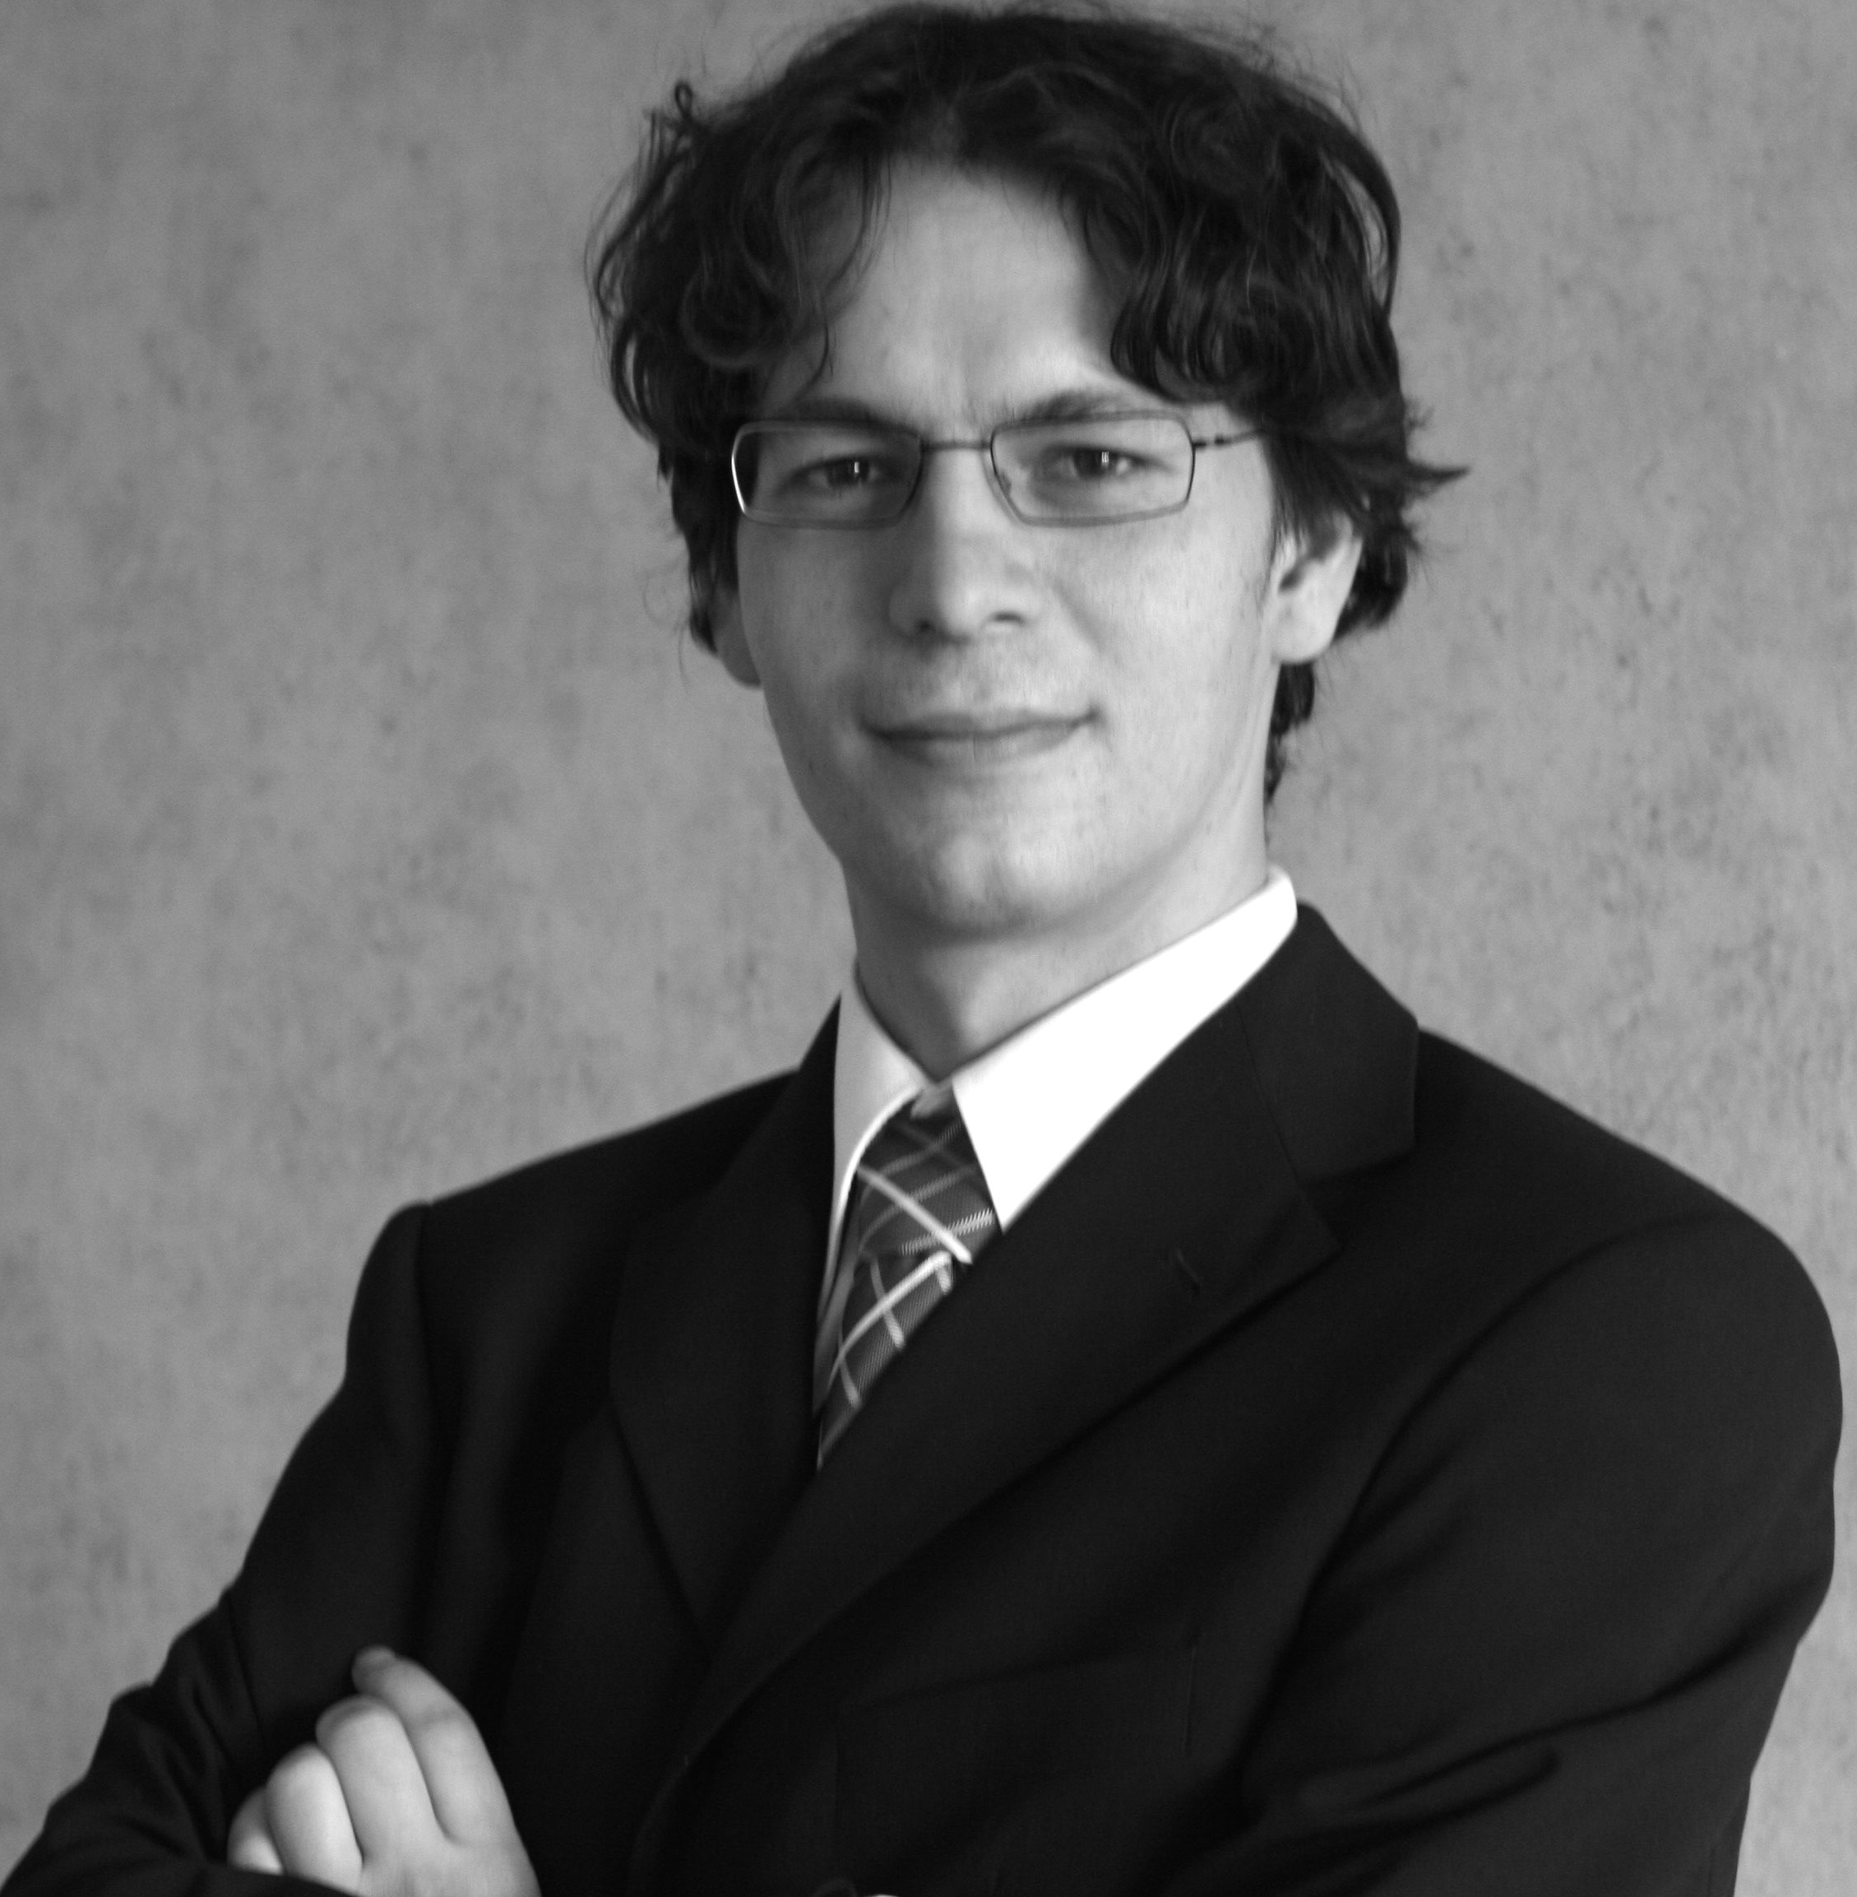
Contacts
MANIPUL, s.r.o.
Letecká 11
SK-831 03 Bratislava
http://www.manipul.sk/
Marián Andraščík
Manipul
andrascik@manipul.sk
Excuber
Slovakia
http://excuber.eu/
Jozef Baláž
Excuber
jozef.balaz@excuber.eu
+421 903 25 1234

